Slide 1
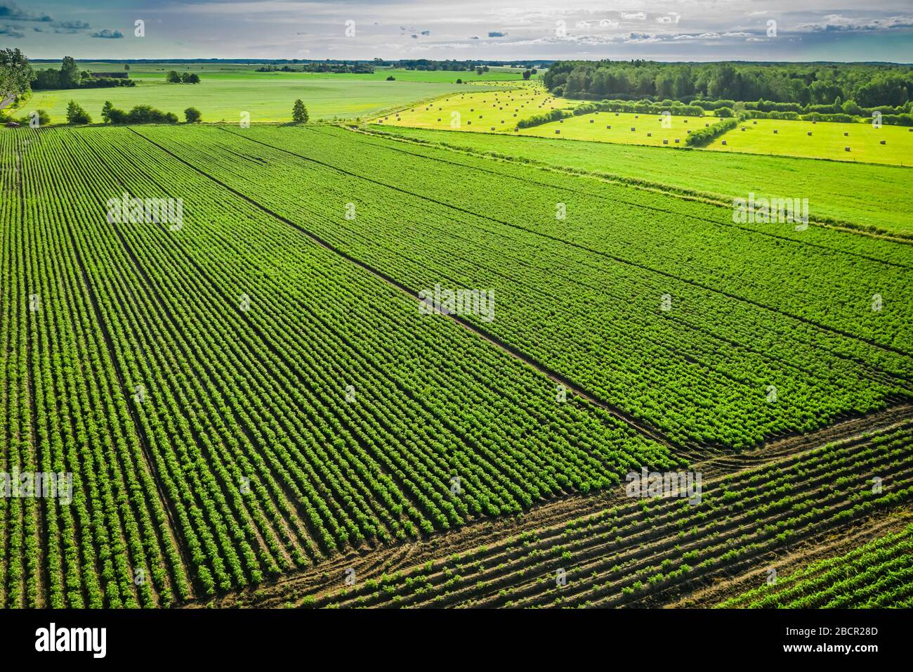
AI-Powered Potato Crop Growth Prediction
Optimizing potato yields with advanced AI and machine learning technologies

Slide 2
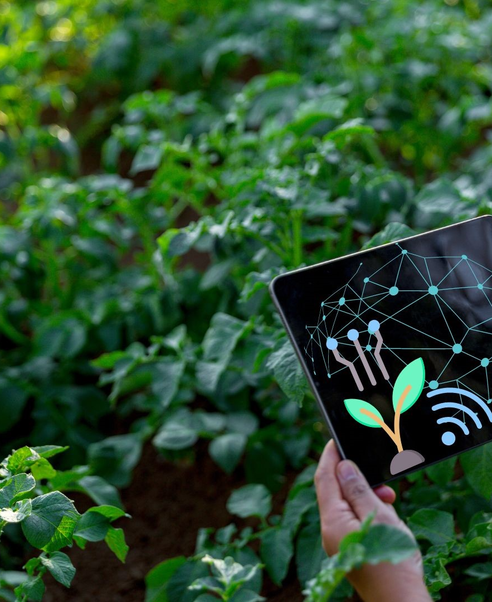
AI-Powered Potato Crop Growth Prediction
AI-powered technology is revolutionizing the way potato farmers approach crop management. By leveraging advanced machine learning algorithms and satellite imagery, this innovative system provides farmers with data-driven insights to optimize potato yield and improve overall crop health.

Slide 3



Introduction
POTATO: A GLOBAL STAPLE
FARMING CHALLENGES
IMPORTANCE OF OPTIMIZATION
Potatoes are one of the world's most important food crops, providing essential carbohydrates, vitamins, and minerals to millions worldwide.
Potato farmers face numerous challenges, including climate change, soil degradation, and disease outbreaks, which can significantly impact crop yields.
Improving potato crop management is crucial to meet the growing global demand for food and ensure food security.
BY ADDRESSING THE CHALLENGES FACED BY POTATO FARMERS, INNOVATIVE SOLUTIONS CAN HELP OPTIMIZE CROP YIELDS, ENHANCE SUSTAINABILITY, AND CONTRIBUTE TO GLOBAL FOOD SECURITY.

Slide 4



Problem Statement
TRADITIONAL FARMING LIMITATIONS
LACK OF ACCURATE GROWTH PREDICTION
LOSS DUE TO LATE DISEASE DETECTION
Reliance on manual observation, uniform resource application across fields, failing to account for specific zone needs
Inability to precisely forecast crop growth stages and nutrient requirements
Delayed identification of crop diseases leading to decreased yields and quality
TRADITIONAL FARMING METHODS ARE OFTEN INEFFICIENT, LACKING THE PRECISION AND DATA-DRIVEN INSIGHTS NEEDED TO OPTIMIZE POTATO CROP MANAGEMENT AND MAXIMIZE YIELDS.

Slide 5



Objective of the Project
USE AI & MACHINE LEARNING
PROVIDE DATA-DRIVEN INSIGHTS
OPTIMIZE POTATO YIELD
Using Deep Learning models/DeepCGM to classify potato crop growth stages from Sentinel-2 satellite imagery. Leveraging NDVI & NDRE indices to extract vegetation health patterns, feeding them into the AI model for accurate growth stage detection.
Mapping nutrient health zones providing visual heatmaps to farmers, highlighting low fertility zones and high-stress regions for corrective actions. visual heatmaps to farmers, highlighting low fertility zones and high-stress regions for corrective actions.
Delivering stage-specific irrigation and fertilizer recommendations to ensure the right resource is applied at the right time.Improving soil health & cost efficiency by reducing overuse of fertilizers and water
THE OVERARCHING OBJECTIVE OF THIS PROJECT IS TO EMPOWER POTATO FARMERS WITH AI-DRIVEN INSIGHTS THAT CAN OPTIMIZE CROP GROWTH, ENHANCE PRODUCTIVITY, AND ENSURE A MORE SUSTAINABLE AND RESILIENT AGRICULTURAL ECOSYSTEM.

Slide 6



Methodology
DATA COLLECTION
AI & ML MODELS
OUTPUT: GROWTH PREDICTION + RECOMMENDATIONS
The system collects Sentinel-2 satellite imagery, weather data, and soil information for the potato fields under analysis. This data serves as the foundation for the AI and machine learning models.
The core of the system is the custom-built
The AI model's outputs are fed into a rule-based engine that generates precise, localized recommendations for irrigation, fertilization, and other management decisions. This helps farmers apply the right resources at the right time and in the right locations to maximize yield.

Slide 7
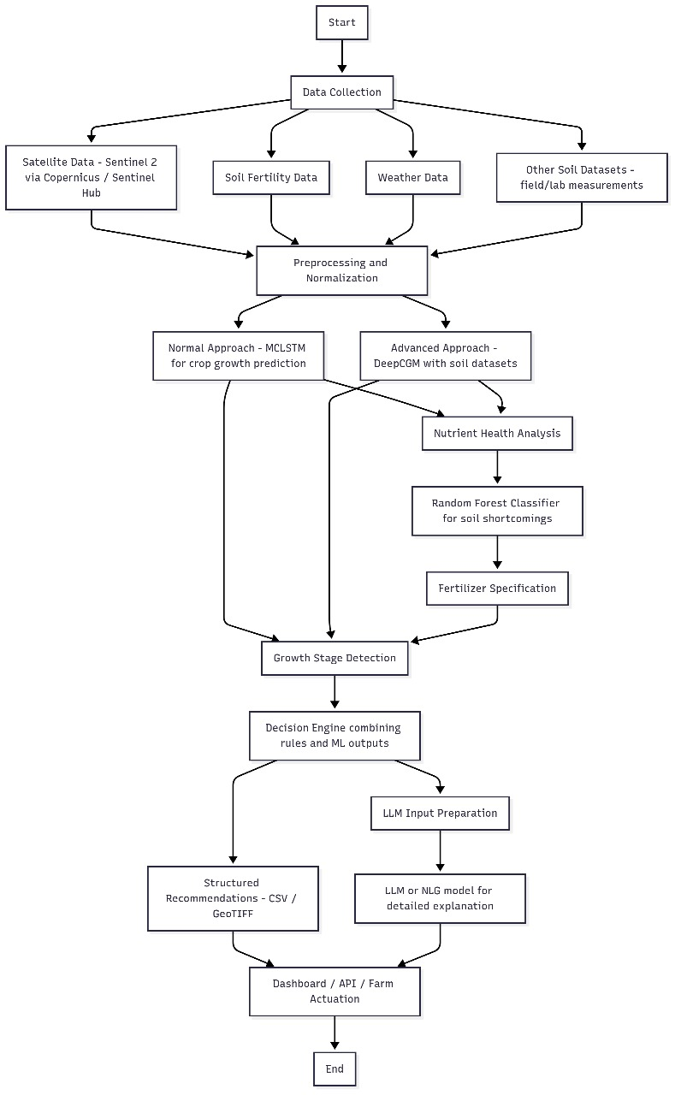
Overall System Diagram:

Slide 8
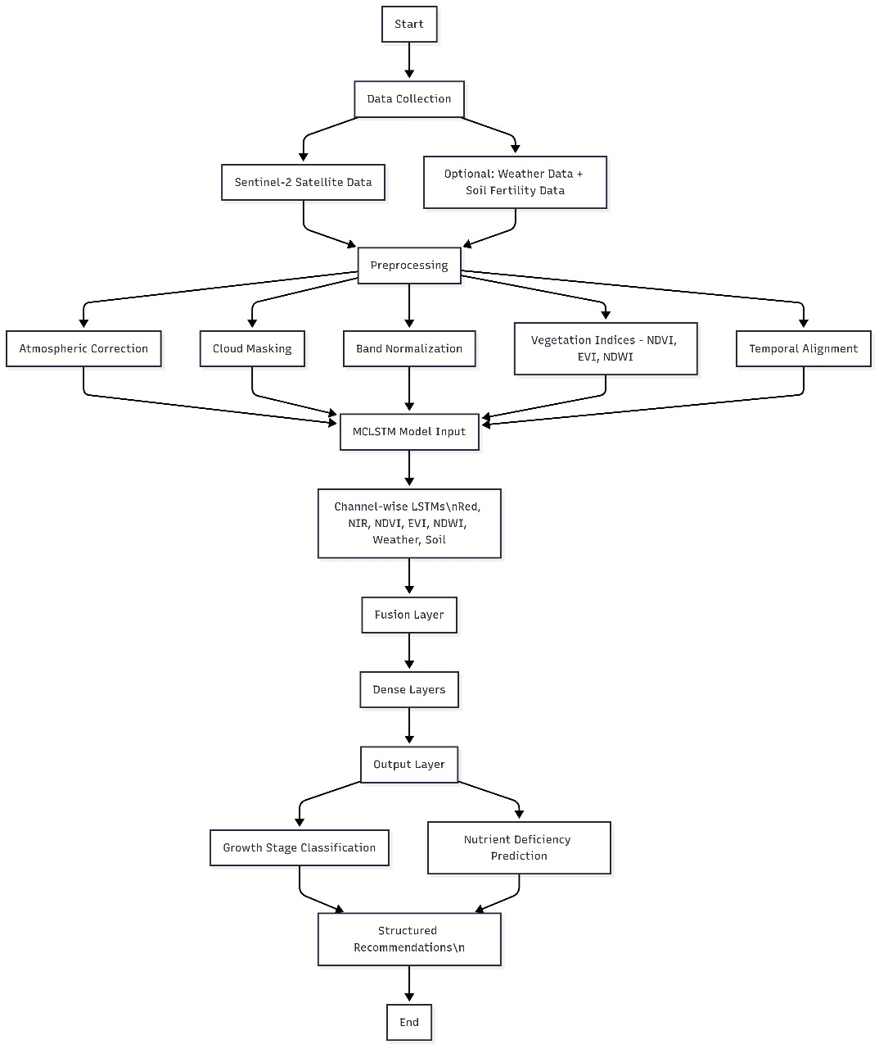
MCLSTM MODEL:

Slide 9




Features of the System
GROWTH PREDICTION
DISEASE DETECTION
SOIL & WEATHER MONITORING
SMART RECOMMENDATIONS
Accurately forecast potato crop growth stages using advanced machine learning models
Leverage computer vision to identify early signs of crop diseases and pests
Integrate real-time data on soil health, temperature, precipitation, and other environmental factors
Provide tailored, data-driven suggestions for optimal irrigation, fertilization, and other crop management practices
BY COMBINING THESE POWERFUL FEATURES, THE AI-POWERED POTATO CROP GROWTH PREDICTION SYSTEM EMPOWERS FARMERS WITH THE INSIGHTS AND TOOLS THEY NEED TO OPTIMIZE THEIR OPERATIONS AND MAXIMIZE THEIR YIELDS.

Slide 10
How It Works
FARMER UPLOADS CROP/SOIL DATA
The farmer provides the system with relevant data about their potato crop, including field coordinates, planting dates, and any available soil or weather information. This data is used as the input for the AI-powered analysis.
AI PROCESSES & PREDICTS GROWTH PATTERNS
The system's AI and machine learning models analyze the provided data, along with satellite imagery and other relevant information, to predict the current and future growth stages of the potato crop. This includes identifying potential issues like nutrient deficiencies or disease outbreaks.
FARMER RECEIVES ACTIONABLE INSIGHTS
Based on the AI's predictions and analysis, the system generates a detailed report for the farmer. This report includes a growth stage classification, a nutrient health heatmap, and precise, localized recommendations for irrigation, fertilization, and other management practices. The farmer can then apply these insights to optimize their crop production.

Slide 11



Future Scope
INTEGRATION WITH IOT SENSORS
REAL-TIME MOBILE APP FOR FARMERS
EXPANSION TO OTHER CROPS
Connect the system with real-time IoT sensors to monitor environmental factors and provide even more accurate, up-to-the-minute recommendations.
Develop a user-friendly mobile application that allows farmers to access growth predictions, disease alerts, and recommendations on the go.
Adapt the AI models to work with various other important crops, expanding the reach and impact of the system beyond just potato farming.
BY INTEGRATING IOT SENSORS, CREATING A REAL-TIME MOBILE APP, AND EXPANDING THE SYSTEM TO OTHER CROPS, THE AI-POWERED POTATO CROP GROWTH PREDICTION SOLUTION CAN BECOME AN EVEN MORE POWERFUL TOOL FOR REVOLUTIONIZING SUSTAINABLE AGRICULTURE AND ENSURING GLOBAL FOOD SECURITY.

Slide 12
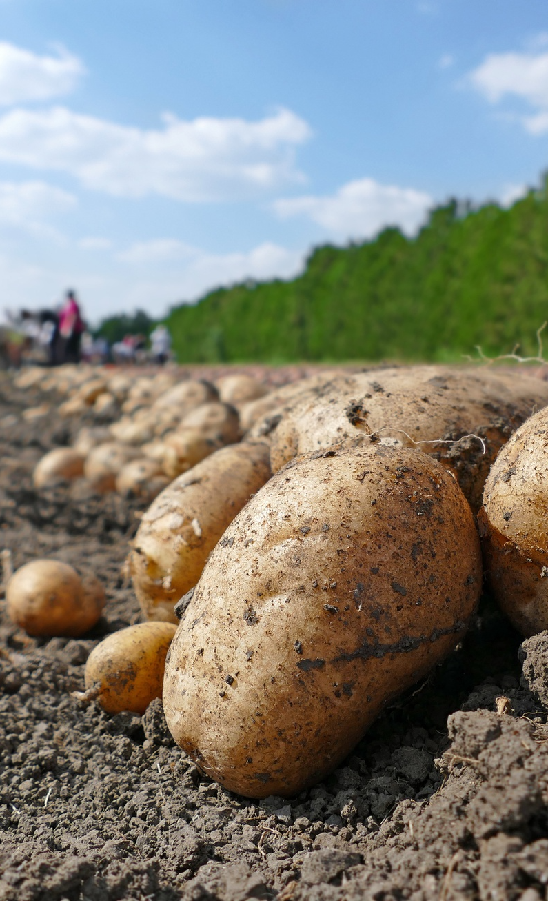
Conclusion
AI has the potential to revolutionize potato farming by providing farmers with data-driven insights and optimizing resource management. The AI-Powered Potato Crop Growth Prediction system demonstrates how advanced technologies can help ensure food security and promote sustainable agriculture. By leveraging satellite imagery, machine learning, and precise recommendations, this solution can lead to higher yields, reduced costs, and improved soil health - ultimately contributing to a more resilient and efficient potato farming industry.

Slide 13
AI-Powered Potato Crop Growth Prediction
A company that specializes in developing AI-powered solutions for optimizing potato crop management and yield.

Slide 14
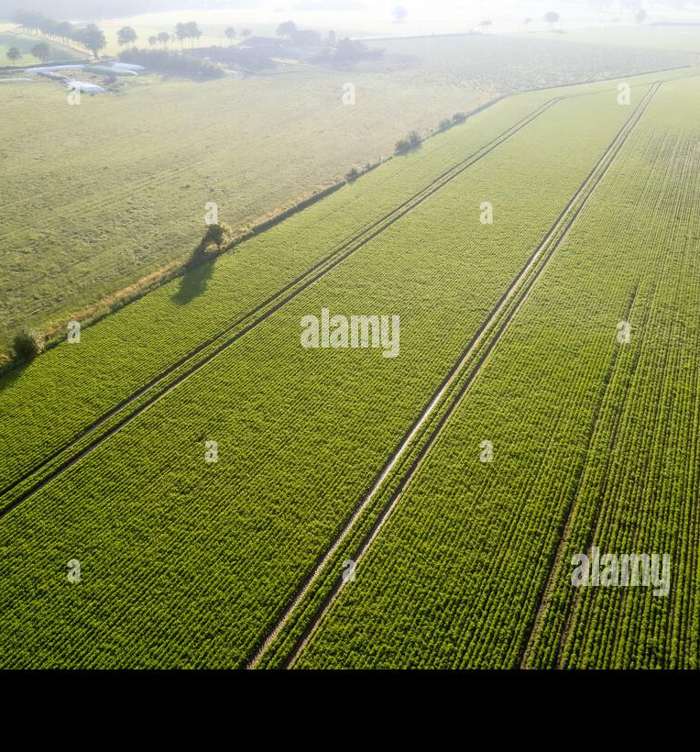
THE AI-POWERED POTATO CROP GROWTH PREDICTION SYSTEM IS A TRANSFORMATIVE SOLUTION THAT EMPOWERS FARMERS TO OPTIMIZE POTATO YIELDS, REDUCE COSTS, AND PROMOTE SUSTAINABLE AGRICULTURE. BY HARNESSING THE POWER OF SATELLITE DATA, MACHINE LEARNING, AND PRECISION RECOMMENDATIONS, THIS INNOVATIVE SYSTEM USHERS IN A NEW ERA OF DATA-DRIVEN DECISION-MAKING FOR THE POTATO FARMING INDUSTRY. WITH ITS ABILITY TO ACCURATELY PREDICT GROWTH STAGES, DETECT DISEASES EARLY, AND PROVIDE TAILORED RESOURCE MANAGEMENT INSIGHTS, THIS TECHNOLOGY HAS THE POTENTIAL TO REVOLUTIONIZE THE WAY FARMERS APPROACH POTATO CULTIVATION, ENSURING FOOD SECURITY AND ENVIRONMENTAL SUSTAINABILITY FOR GENERATIONS TO COME.

